Slide 1
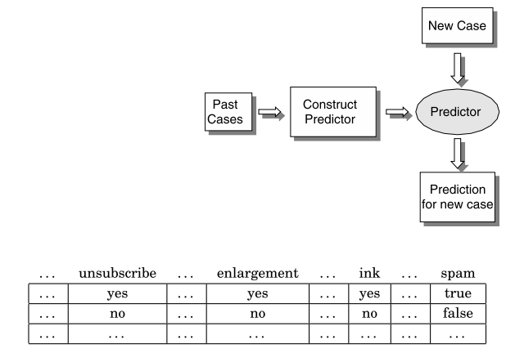
Text Representation

Slide 2
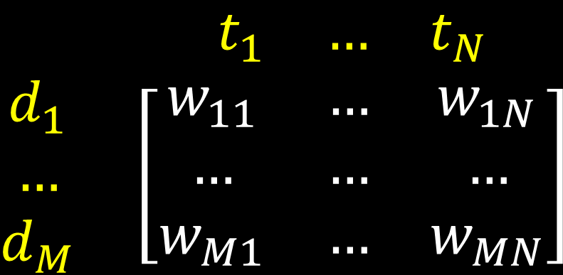
Vectorizing the Data
Dataset
d1: this is a document
d2: this document is good
d3: this document is good document
d4: is this a document
Vocabulary / Dictionary (t₁, … , T_{N})
Dataset (d₁, …, d_{M})
$$\begin{matrix} & \begin{matrix}t_{1} & … & t_{N}\end{matrix} \\ \begin{matrix}d_{1} \\ … \\ d_{M}\end{matrix} & \left[\begin{matrix}w_{11} & … & w_{1N} \\ … & … & … \\ w_{M1} & … & w_{MN}\end{matrix}\right]\end{matrix}$$
 | this | Is | a | document | Good
d1 | 1 | 1 | 1 | 1 | 0
d2 | 1 | 1 | 0 | 1 | 1
d3 | 1 | 1 | 0 | 2 | 1
d4 | 1 | 1 | 1 | 1 | 0

Slide 3
Representation Schemes
Frequency based
 | diet | food | sports | ground | Player
d1 | 1 | 0 | 12 | 5 | 9
d2 | 2 | 2 | 15 | 7 | 20
d3 | 20 | 13 | 2 | 6 | 1
d4 | 17 | 12 | 0 | 5 | 2
 | diet | food | sports | ground | Player
d1 | 1 | 0 | 12 | 5 | 9
d2 | 2 | 2 | 15 | 7 | 20
d3 | 20 | 13 | 2 | 6 | 1
d4 | 17 | 12 | 0 | 5 | 2
 | diet | food | sports | ground | Player
d1 | 1 | 0 | 1 | 1 | 1
d2 | 1 | 1 | 1 | 1 | 1
d3 | 1 | 1 | 1 | 1 | 1
d4 | 1 | 1 | 0 | 1 | 1
Binary

Slide 4
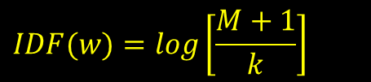
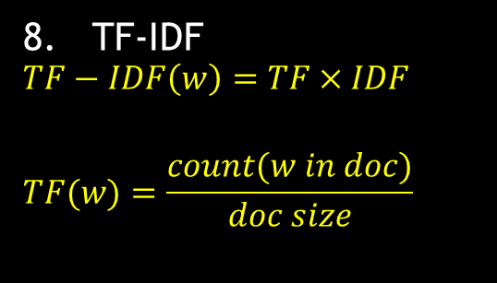
 | diet | food | sports | ground | Player
d1 | 1 | 0 | 12 | 5 | 9
d2 | 2 | 2 | 15 | 7 | 20
d3 | 20 | 13 | 2 | 6 | 1
d4 | 17 | 12 | 0 | 5 | 2
 | diet | food | sports | ground | Player
d1 | 0.01 | 0.0 | 1.07 | 0.69 | 0.95
d2 | 0.30 | 0.30 | 1.17 | 0.84 | 1.30
d3 | 1.30 | 1.11 | 0.30 | 0.77 | 0.01
d4 | 1.23 | 1.07 | 0.0 | 0.69 | 0.30
Log-Frequency
 | diet | food | sports | ground | Player
d1 | 1 | 0 | 12 | 5 | 9
d2 | 2 | 2 | 15 | 7 | 20
d3 | 20 | 13 | 2 | 6 | 1
d4 | 17 | 12 | 0 | 5 | 2
TF-IDF
$$TF−IDF\left(w\right)=TF×IDF$$
$$TF(w)=\frac{count(w in doc)}{doc size}$$
 | diet | food | sports | ground | Player
d1 | 0.0009 | 0 | 0.0266 | 0.0048 | 0.0087
d2 | 0.0019 | 0.0044 | 0.0332 | 0.0067 | 0.0193
d3 | 0.0193 | 0.0288 | 0.0044 | 0.0058 | 0.0009
d4 | 0.0164 | 0.0266 | 0 | 0.0048 | 0.0019
$$IDF(w)=log\left[\frac{M+1}{k}\right]$$
* Assuming all docs to be of 100 size

